Slide 1


ISTQB Certified Tester Foundation Level
Module 4 of 6: Test Design Techniques
February, 2017

Slide 2
Study Sessions
These study packs are intended as sessions directly from the chapters in the syllabus
There are 6 main modules
Fundamentals of Testing
Testing Throughout the Software Life Cycle
Static Techniques
Test Design Techniques
Test Management
Tool Support for Testing

Slide 3
Covered in this session...
The test development process
Categories of test design techniques
Specification-based or black box techniques
Structure-based or white box techniques
Experienced-based techniques
Choosing test techniques

Slide 4
Test Development Process
Notes:
Learning Objectives
4.1 The test development process (K2)
LO-4.1.1 Differentiate between a test design specification, test case specification and test
procedure specification. (K2)
LO-4.1.2 Compare the terms test condition, test case and test procedure. (K2)
LO-4.1.3 Evaluate the quality of test cases. Do they:
o show clear traceability to the requirements;
o contain an expected result. (K2)
LO-4.1.4 Translate test cases into a well-structured test procedure specification at a level of
detail relevant to the knowledge of the testers. (K3)

Slide 5
Test Development Process
The process can be
Very informal with little or no documentation
Very formal with lots of documentation
Depends on the context for testing
Organisation and the type of software
Maturity of testing and development processes
Time constraints and the people involved
Remember Principle 6 – Testing is context dependent
E.g. May test differently on web info page vs. Safety critical breaking system
Notes:
Ask for examples from students of different levels of formality
Anyone worked with no documentation?
How did they do test design?
Remember – TESTING IS CONTEXT DEPENDENT
Principle 6 – Testing is context dependent
Testing is done differently in different contexts. For example, safety-critical software is tested differently from an e-commerce site.

Slide 6
How would you test software without requirements?
Software
Experienced User
User Manual
Heuristics
What we know of software

Slide 7
How would you test software with 1,000 documents?
Business Requirements
Use Cases
Technical Requirements
Architecture Diagrams
Process Flows
Transactions
Notes:
Prioritise!
Date, version, assess content – is it testable? Is it up to date? Well written?...
Which document is most relevant for phase of testing? Remember V-model?

Slide 8
Test Design and the Fundamental Test Process
Planning and Control
Test Closure
Analysis and Design
Implementation and Execution
Evaluate Exit Criteria and Reporting
1. Analyse test basis
2. Identify test conditions (using techniques)
3. Design test cases and test data
4. Develop test procedure specification
5. Develop test execution schedule
Notes:
This is where test design (on the right) fits into the ISTQB 5 Step Fundamental Test Process (on the left)

Slide 9
Test Development Process
1. Analyse Test Basis and Prioritise
3. Design Test Cases and Prioritise
4. Develop Test Procedure Specification and Prioritise
2. Identify Test Conditions and Prioritise
5. Develop Test Execution Schedule and Prioritise
Notes:
For designing tests.
Each step will be explained in more detail in the coming slides…

Slide 10

Step 1: Analyse the Test Basis
Select the Test Basis
Study and evaluate testability
E.g. Business Requirements Specification, Use Cases, etc…
Prioritise
Which test basis to use for testing first?

Slide 11
Step 2: Identify Test Conditions
Use the chosen test design technique
The approach may be specified in the Test Strategy
List the test conditions
Prioritise
Ensure the most important test conditions are identified
Traceability
From test conditions back to specifications and requirements
Enables impact analysis when things change
Helps to determine requirements coverage in both planning and execution

Slide 12
What is a Test Condition?
An item or event that could be verified by one or more test cases.
Eg.
Function
Transaction
Feature
Quality characteristic
Structural element
Testers usually brainstorm all the possible test conditions for the requirement/feature that they are testing
Then we pick the most appropriate test conditions and build into test cases

Slide 13

Examples of Test Conditions
Employee Record
Add Delete Edit Save
Screen for an Employee Record
Functions: Add, Delete, Modify…
Features: Role based security – who can delete?
Fields: Date Joined (Date formats)
Role (from a drop down list)
Quality Characteristics: Concurrent users, Usability,
Transaction time to save changes?
Structural Elements: Page navigation, Variables in code (white box), Coverage?
First Name:
Last Name:
Date Joined:
Role:
Test conditions are also referred to as the Test Design Specification (IEEE 829 - Standard for Software Test Documentation)
Notes:
Ask participants to brain storm some test conditions for each type...
Functions
Add
Delete
Modify
Feature:
Security – role based can make changes?
Fields
Date Commenced (Date formats)
Role (from a drop down list)
Quality Characteristics
Concurrent users?
Usability?
Transaction time to save changes?

Slide 14
Step 3: Identify Test Cases
Select the test conditions to be tested
Design test case
Test Case Specification
A document specifying a set of test cases
Objective
Inputs
Test actions (steps)
Expected results
Execution preconditions
Specified in the IEEE – 829: Standard for Software Test Documentation
Test cases are also referred to as the Test Case Specification

Slide 15
What is a Test Case?
A set of input values
E.g. Debit transaction $205.70 from Account for Jane Smith
With Preconditions
E.g. Account for customer Jane Smith with zero balance
Expected results and post conditions
E.g. Message to user “Insufficient funds”, Account for Jane Smith is not debited.
For a particular objective or test condition
E.g. Test condition “Can’t debit a zero balance account”
To verify compliance with a specific requirement or exercise a particular program path
E.g. Requirement “When a customer attempts to debit an account with insufficient funds an error message is displayed and the account is not debited.
Notes:
The ‘Standard for Software Test Documentation’ (IEEE 829) describes the content of test design specifications (containing test conditions) and test case specifications.

Slide 16
Step 4: Develop the Test Procedure Specification
During test implementation
Test cases are developed, implemented, prioritised and organised into the test procedure specification
Specifies sequence of action
Manual test script
Automated test procedure when script executed by a tool
Prioritise Test Procedure Specifications
Want to execute the most important ones first!
Test Procedure Specification is also in IEEE 829
Test Procedure 1
1.
2.
3.
4.
5.

Slide 17
Step 5: Develop the Test Execution Schedule
Order of test procedures and possibly automated scripts to execute
By whom
Take into account
Regression tests
Prioritisation
Technical and logical dependencies
(Eg. Must execute Test Case A, before Test Case B to put account into arrears that is needed for Test Case B)
Example: the “Test Lab” in HP Quality Center with test cases in set order assigned to different testers
Test Procedure 1
1.
2.
3.
4.
5.

Slide 18
Categories of Test Design Techniques
Notes:
Learning Objectives
4.2 Categories of test design techniques (K2)
LO-4.2.1 Recall reasons that both specification-based (black-box) and structure-based (whitebox)
approaches to test case design are useful, and list the common techniques for
each. (K1)
LO-4.2.2 Explain the characteristics and differences between specification-based testing,
structure-based testing and experience-based testing. (K2)

Slide 19
Categories of Test Design Techniques
Black-box Techniques
Specification-based
Equivalence partitioning
Boundary value analysis
Decision table testing
State transition testing
Use case testing
Experienced-based
Error guessing
Fault attack
Exploratory testing approach
White-box Techniques
Structure-based
Statement testing and coverage
Decision testing and coverage
Other structure-based techniques

Slide 20
Why use test design techniques?
Consistency
“Best” practice
Systematic
Testers may have different levels of experience
Save time
Impossible to test all permutations, therefore we have to choose what we will test
So, we need an intelligent way of devising what to test!
Remember Principle 2 – Exhaustive testing is impossible

Slide 21
Specification-based or black-box techniques
Systematically derive tests from formal or informal models (descriptions) used for the specification of the software
Analysis of the test basis
Based on documentation or what we know
“what” the system should do
Without reference to its internal structure
Notes:
Learning Objectives
4.3 Specification-based or Black-box Techniques (K3)
LO-4.3.1 Write test cases from given software models using equivalence partitioning, boundary
value analysis, decision tables and state transition diagrams/tables (K3)
LO-4.3.2 Explain the main purpose of each of the four testing techniques, what level and type of
testing could use the technique, and how coverage may be measured (K2)
LO-4.3.3 Explain the concept of use case testing and its benefits (K2)

Slide 22
Structure-based or white-box techniques
Derive test cases from
Analysis of the structure of the component or system
Code, detailed design and menu structure
“how” the system is constructed
The extent of test coverage can be measured (by a tool) for existing test cases and further test cases can be derived to increase coverage
0
Notes:
Learning Objectives
4.4 Structure-based or White-box Techniques (K4)
LO-4.4.1 Describe the concept and value of code coverage (K2)
LO-4.4.2 Explain the concepts of statement and decision coverage, and give reasons why these
concepts can also be used at test levels other than component testing (e.g., on
business procedures at system level) (K2)
LO-4.4.3 Write test cases from given control flows using statement and decision test design
techniques (K3)
LO-4.4.4 Assess statement and decision coverage for completeness with respect to defined exit
criteria. K4)

Slide 23
Experienced-based techniques
Utilising the knowledge and experience of people to derive test cases
Knowledge of testers, developers, users, stakeholders, etc.
About the software, its usage and its environment
Knowledge about likely defects and their distribution
Useful when augmenting with systematic techniques
Can give varying results of effectiveness depending on the testers’ experience
Notes:
When used to augment systematic techniques, these techniques can be useful in identifying special tests not easily captured by formal techniques, especially when applied after more formal approaches.
However, this technique may yield widely varying degrees of effectiveness, depending on the testers’ experience.
Learning Objectives
4.5 Experience-based Techniques (K2)
LO-4.5.1 Recall reasons for writing test cases based on intuition, experience and knowledge
about common defects (K1)
LO-4.5.2 Compare experience-based techniques with specification-based testing techniques
(K2)

Slide 24
Equivalence Partitioning
Specification-based (Black-box) Techniques
Notes:
Black box in the corner means it’s a black box or specification technique

Slide 25
Equivalence Partitioning
Inputs are divided into groups that are expected to behave similar
Can be done for valid and invalid partitions
Can also be identified for
Outputs
Internal values and interface parameters
Time-related values
Can be done at all levels/phases of testing
Partitions are also called Classes
Notes:
Black box in the corner means it’s a black box or specification technique

Slide 26
Equivalence Partitioning
Activity
Let’s derive the equivalence classes for an application that lets you apply for your driver’s license
In Victoria, Australia you must be at least 18 yrs. old to apply for your probationary license
Let’s say theoretically you must stop driving when you are 90 yrs. old
Invalid
Valid
Invalid
17
18
89
90
Others? Non-integer
Notes:
Black box in the corner means it’s a black box or specification technique
Now – choose 3 values that will test in each partition for this scenario
E.g. 15, 45, 91
The theory being that we don’t need to test every single number because one value should behave the same as other values in the same class/partition.
This is an efficient way of testing!

Slide 27
Boundary Value Analysis
Specification-based (Black-box) Techniques

Slide 28
Boundary Value Analysis
Behaviour at the edge of a partition is more likely to be incorrect
Defects lurk on boundaries!
Can be done at all levels/phases of testing
Detailed specifications are helpful
Good at finding defects
Good at finding rounding errors
Can be used on input screens as well as ranges – e.g. time out, transaction speed, table size
Notes:
Black box in the corner means it’s a black box or specification technique

Slide 29
Boundary Value Analysis
Back to our activity…
In Victoria you must be at least 18 yrs. old to apply for your probationary license
Let’s say theoretically you must stop driving when you are 90 yrs Old
Invalid
Valid
Invalid
17
18
89
90
Question: What values would you choose to test the boundaries?
Answer: 17,18 and 89, 90
There is a variant called 3-BVA
On the boundary and either side = 17,18, 19 and 88, 89, 90
Notes:
Black box in the corner means it’s a black box or specification technique

Slide 30
Why do both EP and BVA?
Use both EP and BVA = Stronger, more thorough testing
If you test only EP you could miss rounding errors
But, could be useful for Acceptance Testing with minimal tests
If you test only BVA and you find an error, you have to test more options anyway – is just the boundary wrong or the whole partition?
But could be useful if there are time pressures and you are looking to find defects first, so test boundaries only.
If you do boundaries only, you have covered all the partitions as well.
Boundary testing requires a lot more tests and may be expensive to set up.

Slide 31
Question: EP
An airline offers pricing as follows; infants < 2 yrs. travel free, children aged between 2-11 yrs. at 75% of adult fare and adults at full price.
Which of the following are age values from different VALID partitions for airfare pricing?
a) 0, 2, 10
b) -1, 1, 3
c) 1, 7, 45
d) 2, 9, 12
Notes:
Answer: C

Slide 32
Question: 2-BVA
An electricity company charges usage <1000 kW at $0.13 per kW, between 1000 and 5000 kW inclusive at $0.22 per kW and >5001 kW at $0.28 per kW
Using 2-BVA what usage inputs should be tested?
a) 1000, 1001, 5000, 5001
b) 999, 1000, 4999, 5000
c) 999, 1000, 5000, 5001
d) 1000, 1001, 4999, 5000
Notes:
Answer: C

Slide 33
Question: 3-BVA
A bank’s saving account earns an additional 2% interest when the balance of the account is greater than $10,000
Using 3-BVA what account balance inputs should be tested?
a) 10,000, 10,001, 10,002
b) 9,999, 10,000, 10,001
c) 9,998, 9,999, 10,000
d) 9,999, 10,001, 10,002
Notes:
Answer: A
Greater than! So 10,001 is the boundary

Slide 34
Decision Tables
Specification-based (Black-box) Techniques

Slide 35
Decision Table Testing
Decision tables are great for requirements with logical conditions
Like complex business rules
The strength of decision tables is that it creates combinations of conditions, inputs situations and events that might be missed
The top part of the table contains combinations of input conditions
The bottom part contains the resultant actions as True or False (Boolean)
Each column can then be considered as a test case of a business rule
Coverage standard could be at least one test for each column to trigger all combinations of conditions.
Exam Tip: Decision Table Testing is good for testing business rules or combinations
Notes:
Black box in the corner means it’s a black box or specification technique

Slide 36

Example: Shipping an online order
Online order system rules
There must be items in the cart
Shipping address must not be a PO. Box
Orders can be placed from accounts with a credit balance
Conditions
Cart has something in it
Shipping address is a PO box
Account balance is in credit
Actions
Item is shipped
Account is debited

Slide 37
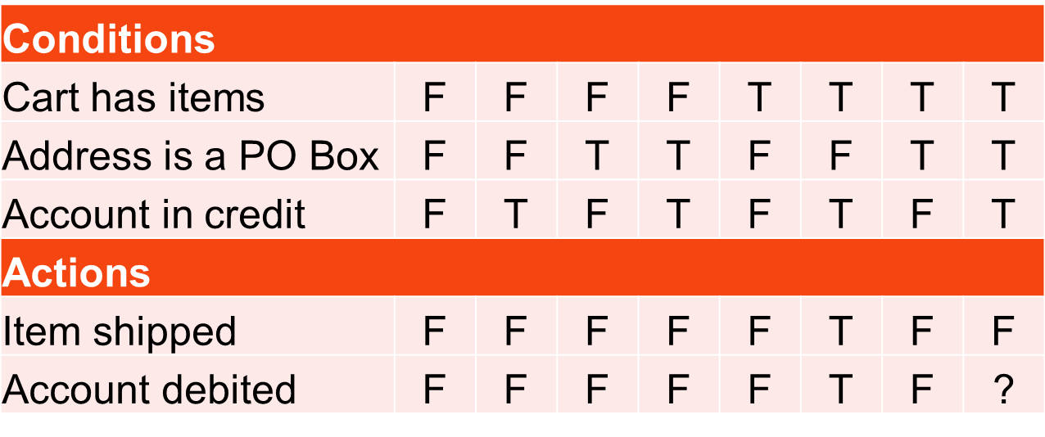
Construct the decision table
Spec doesn’t say
Not feasible, so remove?
Same resulting actions… do conditions matter?
Each column is a test case

Slide 38
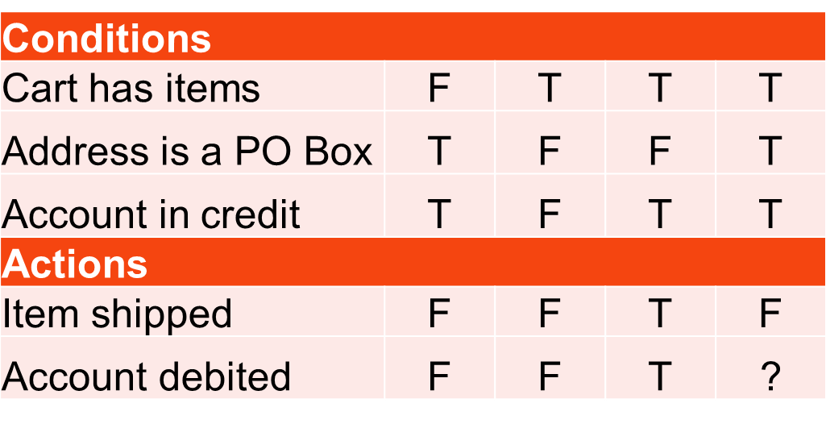
Rationalise the decision table
Be careful with assumptions made when rationalising
You may remove valid or important combinations

Slide 39
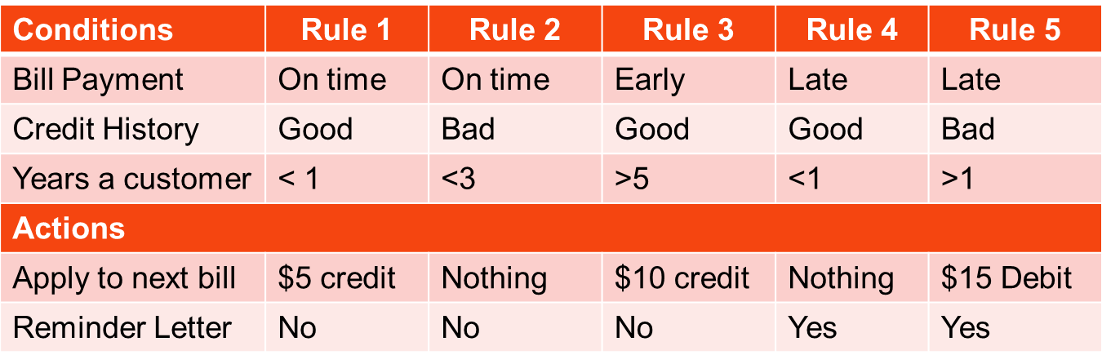
Question: Decision table
Test case A: 2 yr customer, pays late, bad credit history
Test case B: 6 month customer, pays on time, bad credit history
A: $5 credit, no letter B: Nothing on next bill, no letter sent
A: nothing on next bill, no letter B: Nothing on next bill, letter sent
A: $15 debit on next bill, letter sent B: $10 credit on next bill, no letter sent
A: $15 debit on next bill, letter sent B: Nothing on next bill, no letter sent
Notes:
Answer: D

Slide 40
State Transition Testing
Specification-based (Black-box) Techniques

Slide 41
State Transition Testing
A system may exhibit a different response depending on current conditions or previous history. A state transition diagram allows a tester to view the software in terms of its states, transitions between states, inputs or events that trigger state changes (transitions) and resulting actions.
Example: a vending machine
money inserted
ask for selection
invalid selection
beep
wait for money
wait for selection
cancel
return money
valid selection
Give item
insufficient funds
ask for money

Slide 42
State Transition Testing
money inserted
invalid selection
ask for selection
beep
wait for money
wait for selection
Model shows:
states the software can occupy (the circles)
transitions between the states (the lines)
events that cause the transitions
actions that result from the transition
cancel
return money
valid selection
Give item
insufficient funds
ask for money

Slide 43
State Transition Testing
Different events may trigger a specific action and transition to another state of the system.
Tests can be designed to cover every state, a typical sequence, every transition or to test invalid transitions
Tip: To cover every state – cover the circles To cover every transition – cover every line
State transition testing may be used in technical automation, modelling a business object or screen dialogue flows (e.g. navigation of web pages)

Slide 44
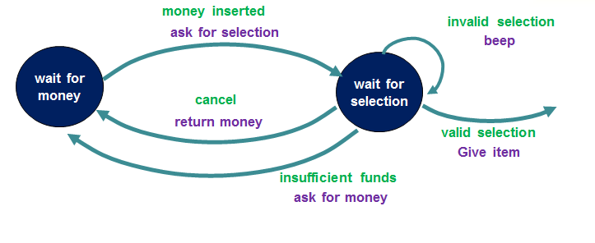
State Transition Testing – Vending Machine Example
Which sequence would be testing a typical transaction flow?
What is the minimum number of tests required to test every state?
Answer: 1
Cross every circle
How many tests are required for testing every transition?
Answer: 3
Cover every line. This is also know as Chow’s 0-switch Coverage

Slide 45
State Transition Diagram Example: Account Login
Cancel
Cancel
S6
Suspend Acct
S1
start
Password invalid
S2
1st attempt
Password invalid
S3
2nd attempt
S4
3rd attempt
Password invalid
Enter Username
Password valid
Password valid
Password valid
S5
Access
account
Typical transaction
Every state
Minimum nbr of tests for state coverage =
Every transition
Minimum nbr of tests for Chow’s 0 switch coverage =
Notes:
Minimum of 2 tests for every State
Need 7 tests for every transition (Chow’s zero switch)

Slide 46
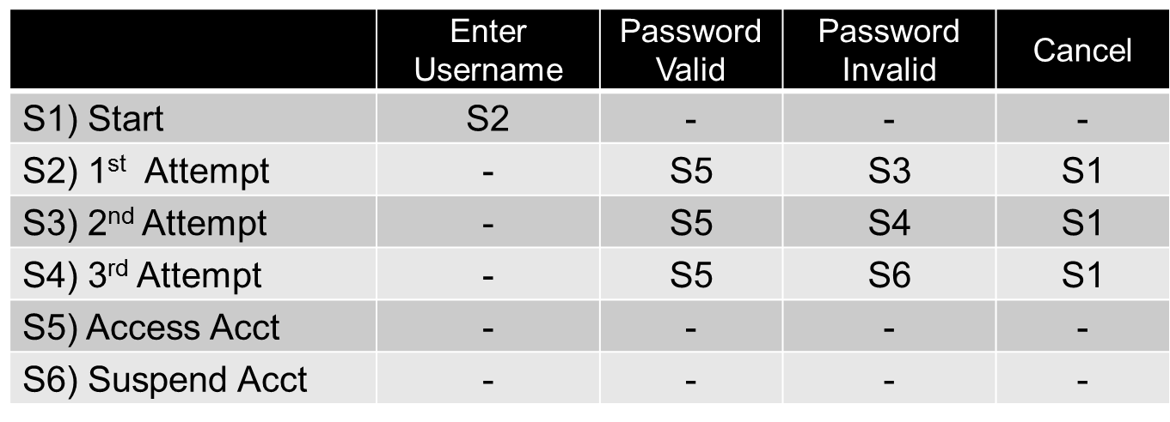

State Transition Table
Use the state table to identify invalid (or unspecified / specification doesn’t say) transitions
Question: Which of the following is not a valid transition?
Password Valid from S3
Cancel from S4
Enter Username from S1
Password Invalid from S5
Notes:
Answer: D

Slide 47
Practice Question
Cancel
S1
Start
Cancel
Password invalid
S6
Suspend Acct
S2
1st attempt
S3
2nd attempt
S4
3rd attempt
Password invalid
Enter Username
Password invalid
Password valid
Password valid
Password valid
S5
Access
Acct
Which two tests will cover all states?
S1 – S2 – S3 – S4 – S5 and S1 – S4 – S6
S1 – S2 – S3 – S4 – S5 and S1 – S2 - S3 – S4 – S6
S1 – S2 – S3 – S4 – S5 and S1 – S2 - S1 – S4 – S6
S1 – S2 – S3 – S4 – S5 and S4 – S6
Notes:
Answer:B

Slide 48
Use Case Testing
Specification-based (Black-box) Techniques

Slide 49
Use Case Testing
Use cases describe process flows through a system
Including mainstream (most likely) and alternate (exception) flows
Interactions between actors (users and the system) to produce a result
Each use case has pre-conditions and post-conditions
Use cases are good for
designing acceptance tests
Involving customers
Finding defects in integration between components
Notes:
Recommended Reading: Writing Effective Use Cases by Alistair Cockburn

Slide 50
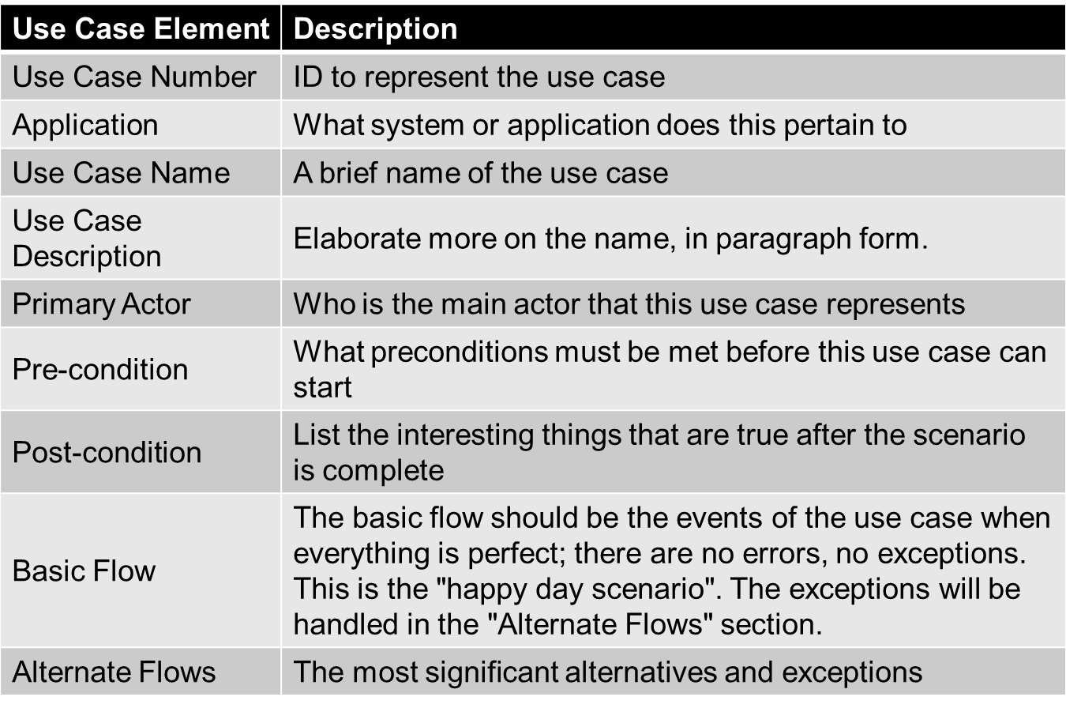
Use Case – Table Format

Slide 51
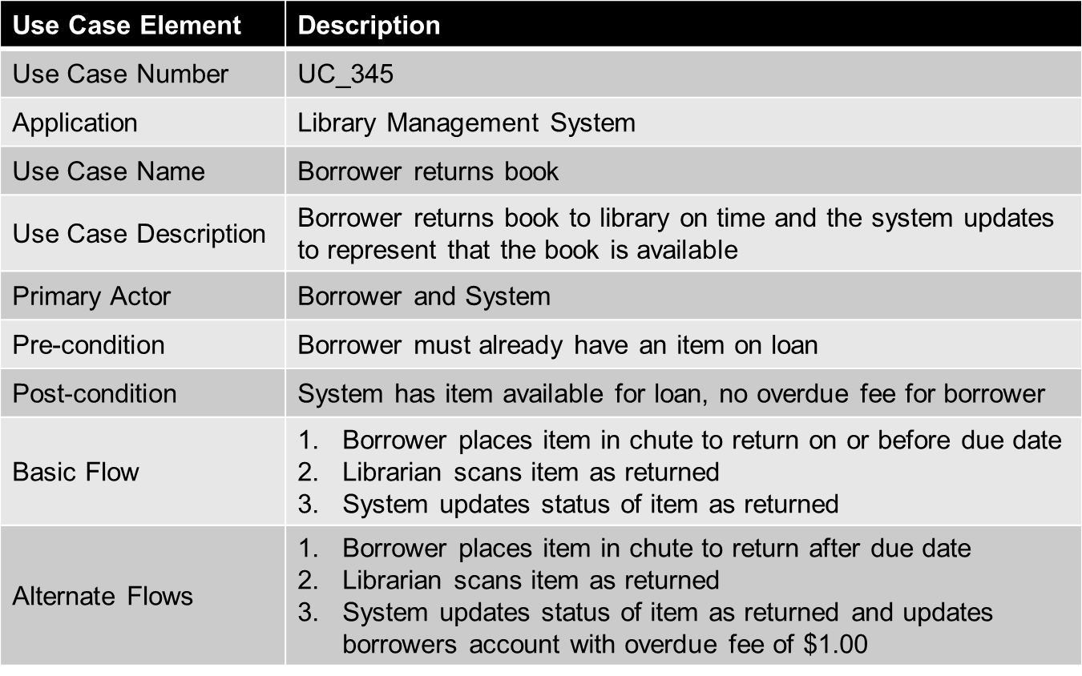
Use Case – Table Format Example

Slide 52
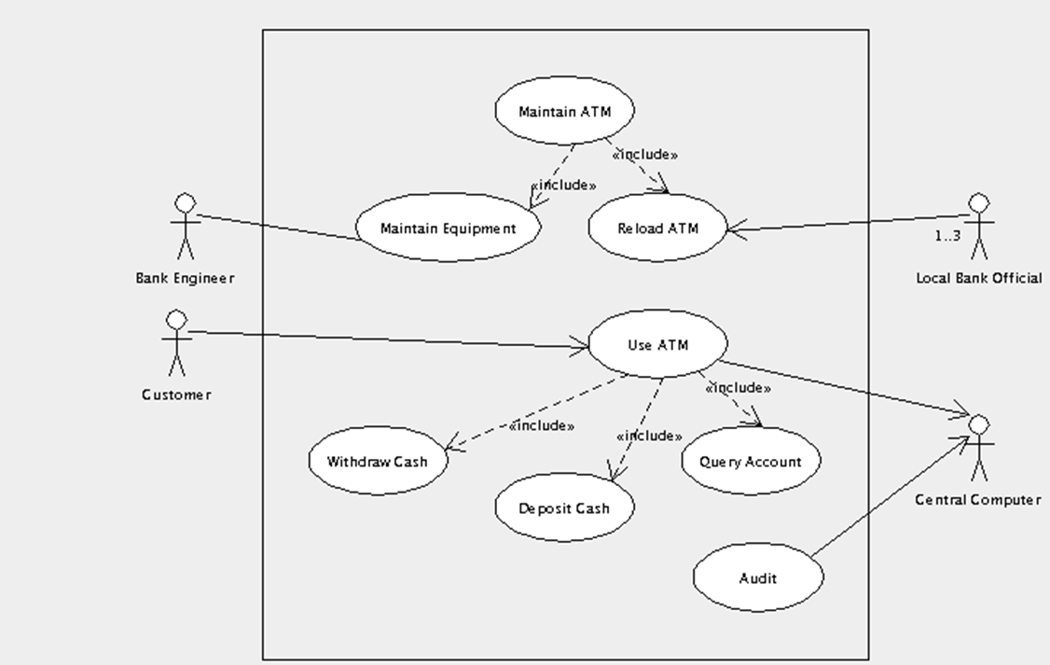
Use Case – Diagram Format
Source: http://argouml-stats.tigris.org/nonav/documentation/manual-0.22/ch04s03.html
Actors: Bank Engineer, Customer, Loan Bank Official and Central Computer
Further Use Cases e.g. for Withdraw Cash for more detail on this transaction
Notes:
http://argouml-stats.tigris.org/nonav/documentation/manual-0.22/ch04s03.html

Slide 53
Statement Testing & Coverage
Structure-based (White-box) Techniques
Notes:
Before we get in to Statement Testing let’s recap on Structure-based or White-box testing….

Slide 54
Structure-based Testing
Based on an identified structure
Component level: code (statement, branches, decisions)
Integration level: call tree diagram
System level: menu structure, business process or web page navigation
Tip: Often see questions related to coverage when talking about structure-based testing as we can measure how many items (lines of code, components, classes, menu items) are exercised by our tests.

Slide 55
Statement Testing and Coverage
Test Coverage
Here we devise test suites with information on how many statements they exercise to achieve a coverage target
Usually involves a tool that measures statement coverage during test execution
Usually for safety critical testing to ensure every statement is tested

Slide 56
How to draw a control flow diagram
A control flow diagram helps show the logic in a program
Read pseudo code for a program
Draw from top to bottom as you would read it
The indentation in the pseudo code should help you read and understand the logic of the program
Statements are boxes
Decisions (e.g. IF) are represented by diamonds
Be consistent
Eg. Always draw to the right for “true” decisions
IF

Slide 57
Statement Testing and Coverage: Example 1
Qty
Question: How many statements are exercised if we set the input value of “Qty” to 10?
1. Read Qty
2. IF Qty > 50
3. Qty = Qty * 0.8
4. End If
5. Print Qty
IF
>50
True
Answer = 4 out of 5 statements
Statement Coverage = 80%
Else
X=Qty*0.8
End If
Print X

Slide 58
Statement Testing and Coverage: Example 2
Qty
Question: How many statements are exercised if we set the input value of “Qty” to 100?
1. Read Qty
2. IF Qty > 50
3. Qty = Qty * 0.8
4. End If
5. Print Qty
IF
>50
True
Answer = 5 out of 5 statements
Statement Coverage = 100%!!!
Else
X=Qty*0.8
End If
Print X
But wait... Are we missing something?
Tip: 100% Statement Coverage means cover all of the boxes!
Notes:
So, you can see that 100% statement coverage does not guarantee thorough testing

Slide 59
Decision Testing & Coverage
Structure-based (White-box) Techniques
Notes:
Before we get in to Statement Testing let’s recap on Structure-based or White-box testing….

Slide 60
Decision Testing and Coverage
Decision coverage is the assessment of the percentage of decision outcomes exercised (e.g. the True and False options of the IF statement)
Related to branch testing and control flow testing
Decision coverage is always stronger than statement coverage
100% decision coverage guarantees 100% statement coverage, but not vice versa
Again, Decision Coverage is usually measured by a tool
Notes:
We need a stronger test!

Slide 61
Decision Testing and Coverage
Qty
Question 1: How many tests are required to achieve 100% statement coverage?
1. Read Qty
2. IF Qty > 50
3. Qty = Qty * 0.8
4. End If
5. Print Qty
True
Answer = 1 Test e.g. Value Qty = 100
IF
>50
Else
Question 2: How many tests are required to achieve 100% decision coverage?
X=Qty*0.8
Answer = 2 Tests, e.g. Values 1 and 100
End If
Tip: 100% Decision Coverage means cover all of the lines!
Print X
Tip: 100% Decision Coverage is always = or > nbr of tests needed for 100% Statement coverage. Never less than!
Notes:
100% decision coverage is similar to 0-switch State Transition testing where you need to cover all of the lines!

Slide 62
Decision Testing: IF with Else
Qty
Question 1: How many tests are required to achieve 100% statement coverage?
IF >50
1. Read Qty
2. IF Qty > 50
3. Qty = Qty * 0.8
4. Else
5. Qty = Qty * 1. 5
6. End If
7. Print Qty
Answer = 2 Tests, e.g. values 1 and 100
True
Else
X=Qty*0.8
Question 2: How many tests are required to achieve 100% decision coverage?
X=Qty * 1.5
End If
Answer = 2 Tests
Print X
Notes:
100% decision coverage is similar to 0-switch State Transition testing where you need to cover all of the lines!

Slide 63
Decision Testing: Nested IF Statements
1. Read Qty
2. IF Qty > 50
3. X = Qty * 0.8
4. Else
5. IF Qty < 0
6. Print “Error”
7. Else
8. X = Qty * 2
9. End If
10. End If
11. Print X
Have a go at drawing the control flow diagram in your notes ☺

Slide 64
Decision Testing: Nested IF Statements
Qty
Question 1: How many tests are required to achieve 100% statement coverage?
IF
>50
True
1. Read Qty
2. IF Qty > 50
3. X = Qty * 0.8
4. Else
5. IF Qty < 0
6. Print “Error”
7. Else
8. X = Qty * 2
9. End If
10. End If
11. Print X
Answer = 3 Tests, e.g. Values 100, -1 and 25
Else
IF
<0
True
Print “Error”
X=Qty*0.8
Else
X=Qty*2
Question 2: How many tests are required to achieve 100% decision coverage?
End If
End If
Answer = 3
Print X

Slide 65
Decision Testing: WHILE LOOP
Read
Question 1: How many tests are required to achieve 100% statement coverage?
1. Read Nbr_Exams
2. WHILE more exams DO
3. Mark answers
4. Collate total marks
5. END WHILE
6. Print “No more to mark”
WHILE
False
Answer = 1 Test
True
Mark
Question 2: How many tests are required to achieve 100% decision coverage?
Collate
End WHILE
Answer = 1 Test
Print
Notes:
100% decision coverage is similar to 0-switch State Transition testing where you need to cover all of the lines!

Slide 66
WHILE LOOP with nested IF Statement
Read
Question 1: Minimum tests to achieve 100% statement coverage?
Read Number of Exams
2. WHILE more exams DO
3. Mark answers
4. Collate total marks
5. IF Score < 65
Fail = Fail + 1
End If
8. END WHILE
9. Print “No more to mark”
WHILE
Answer = 1 Test
False
True
Mark
Question 2: Minimum tests to achieve 100% decision coverage?
Collate
IF < 65
Fail
Answer = 1 Test
End If
End WHILE
Tip: Anything within a WHILE LOOP can be covered with only 1 test!
Print
Notes:
You could have 40 nested if statement WITHIN the DO WHILE LOOP and you would still only need one test case… probably would need data for a lot of exams for this example in that case!
Answer = 1 for statement and decision!
However – If the “IF” statement was AFTER the END WHILE statement you would need more tests

Slide 67
WHILE LOOP and more IF statements
Read
1. Read Number of Exams
2. WHILE more exams DO
3. Mark answers
4. Collate total marks
5. IF Score < 65
6. Fail = Fail + 1
7. End IF
8. END WHILE
9. Class Result = Fail/Exams
10. IF Fail < 30%
11. Print “Smart Class”
12. ELSE
13. Print “Poor Trainer”
14. END IF
WHILE
Have a go at drawing the control flow diagram
Mark & Collate
IF < 65
Fail
Question 1: Minimum tests to achieve 100% statement coverage?
End If
End WHILE
Answer = 2
Class Result
Question 2: Minimum tests to achieve 100% decision coverage?
IF < 30
Smart
Poor Trainer
Answer = 2
END IF
Notes:
Watch out! IF statements are OUTSIDE of the WHILE LOOP
Need another test…
Answer = 2 Statement
Answer =2 Decision

Slide 68
Other Structure-based Techniques
There are even stronger coverage levels than decision coverage
E.g. LCSAJ, combination coverage
We have been looking at detailed low-level coverage, but coverage can also be applied to higher-levels like…
System Testing: % of menu items covered by test cases
Integration Testing: % components exercised

Slide 69
Error Guess & Exploratory Testing
Experienced-based techniques
Notes:
Before we get in to Statement Testing let’s recap on Structure-based or White-box testing….

Slide 70
Experienced-based techniques
Utilising tester’s skill, intuition and experience with similar applications or technologies
Useful when complementing systematic techniques and when special tests not easily captured by formal techniques
Can yield varying degrees of effectiveness
Error Guessing
Anticipate defects based on experience
Common knowledge of system, data and why system fails
Or develop a list of possible errors and design tests to systemically attack these errors: this approach is called Fault Attack

Slide 71
Exploratory Testing
Concurrent test design, execution, logging and learning how the system behaves
Tester builds a “mental model” of the system while they test it
Useful approach when
there are few or inadequate specifications
severe time pressure
complementing more formal testing
can be used to help ensure the most serious defects are found

Slide 72
Exploratory Testing
Is an approach not a technique
Also known as Session-Based Test Management (SBTM)
Based on a Test Charter
A specified mission in a set time.
E.g. Look for bugs creating forms using IE7 for 60 minutes
Include objectives and time box the session
Tester records notes on how the session went including obstacles encountered and suggestions on where to focus future sessions
Collate metrics on Exploratory Testing to show effectiveness
E.g. Hours spent and number of defects found by severity
Notes:
Good article on SBTM - http://www.satisfice.com/articles/sbtm.pdf
http://www.satisfice.com/articles/et-article.pdf

Slide 73
Choosing Techniques
Notes:
Learning Objectives
4.6 Choosing Test Techniques (K2)
LO-4.6.1 Classify test design techniques according to their fitness to a given context, for the test
basis, respective models and software characteristics (K2)

Slide 74
Choosing Test Techniques
The choice depends on a number of factors…
Type of system
Regulatory or legal standards
Customer or contract requirements
Level of risk
Test objectives
Documentation available
Knowledge of testers
Time and budget
Software Development Lifecycle Model
Previous experience of the type of defects found
Notes:
Ask the students what factors they think would determine which techniques to use

Slide 75
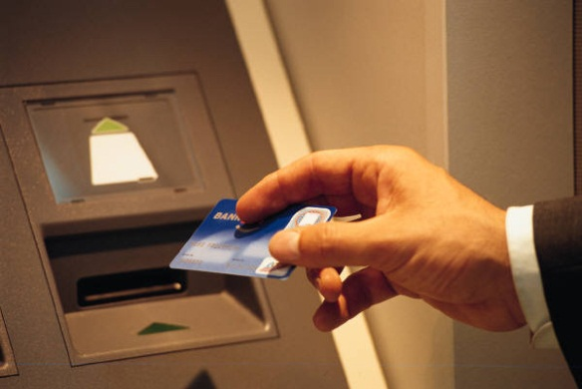
Question 1: Which techniques would you use?
Scenario
Banking application
Previous problems with
rounding errors
Lots of combinations
of possible factors
Good documentation
Experienced testers
Time constraints
Techniques
Equivalence Partitioning
Boundary Value Analysis
State transition testing
Decision tables
Use case testing
Statement testing
Decision testing
Error guessing
Exploratory testing

Slide 76

Question 2: Which techniques would you use?
Scenario
Web site
Little documentation
Previous problems with navigation
Experienced testers
Time constraints
Techniques
Equivalence Partitioning
Boundary Value Analysis
State transition testing
Decision tables
Use case testing
Statement testing
Decision testing
Error guessing
Exploratory testing

Slide 77

Question 3: Which techniques would you use?
Scenario
Train automatic braking system
Lots of documentation
Previous problems with
untested combinations
Safety standards require
decision coverage
High risk
Experienced testers
Techniques
Equivalence Partitioning
Boundary Value Analysis
State transition testing
Decision tables
Use case testing
Statement testing
Decision testing
Error guessing
Exploratory testing

Slide 78
QUESTIONS
End of Module 4

Slide 79
End of Module Learning Check
Which category of test techniques does Decision Testing belong to?
Specification-based
Experience-based
Structure-based
Black-box
Which of the following is a false characteristic of “Good” testing?
Is always very thorough
Test early
Focus on objectives
Testing activity for every development activity
Notes:
c) Structure-based white box testing
A) is false because testing is context dependent

Slide 80
ISTQB Practice Exam Question 1
One of the coverage goals for the project is 100% decision coverage. The following 3 tests have been executed for the control flow graph below.
Test A covers path: A, B, D, F, G
Test B covers path: A, C, F, G
Test C covers path: A, C, F, C, F, C, F, G
Which of the following statements related to the decision coverage goal is correct?
Decision D has not been tested completely.
100% decision coverage has been achieved.
Decision E has not been tested completely.
Decision F not been tested completely.
A
B
C
D
E
F
G
Notes:
This is a true-false question that requires the ability to analyze a control flow
and tests. This requires analysis work.
A is correct because D is a decision
Wrong is in B: D is a decision with the left entry not being executed.
Wrong is in C: E is not a decision.
Wrong is in D: F has been completely tested.ith the left entry not being executed. E is not a decision.

Slide 81
ISTQB Practice Exam Question 2
A bank application determines the creditworthiness of customers. The application uses a set of rules to determine the upper limit of the credit amount. Which of the following black-box test design techniques is best for testing the application?
Decision table testing
State transition testing
Use case testing
Equivalence partitioning
Notes:
This is a best answer question that requires the ability to recognize a
specific characteristic of a test design technique in context.
A is correct because decision tables cover “logical conditions”, actions and rules.
Wrong is in B: context does not highlight the aspect of state changes.
Wrong is in C: context does not highlight the aspect of use cases.
Wrong is in D context does not highlight the aspect of building equivalence
classes.
When testing this application in reality all the techniques in the distracters
do apply, but A is best.

